Slide 1
Turkey Innovative Approach to Combustion Byproducts
SBB Energy – ABH

Slide 2
Agenda
Introduction
Innovative magnesium FGD vs standard calcium FGD
Combustion Byproducts - application as fertilizer
Kangal Tirmik - case study
Summary

Slide 3
Agenda
Introduction
Innovative magnesium FGD vs standard calcium FGD
Combustion Byproducts - application as fertilizer
Kangal Tirmik - case study
Summary

Slide 4
Agenda
Introduction
Innovative magnesium FGD vs standard calcium FGD
Combustion Byproducts - application as fertilizer
Kangal Tirmik - case study
Summary

Slide 5
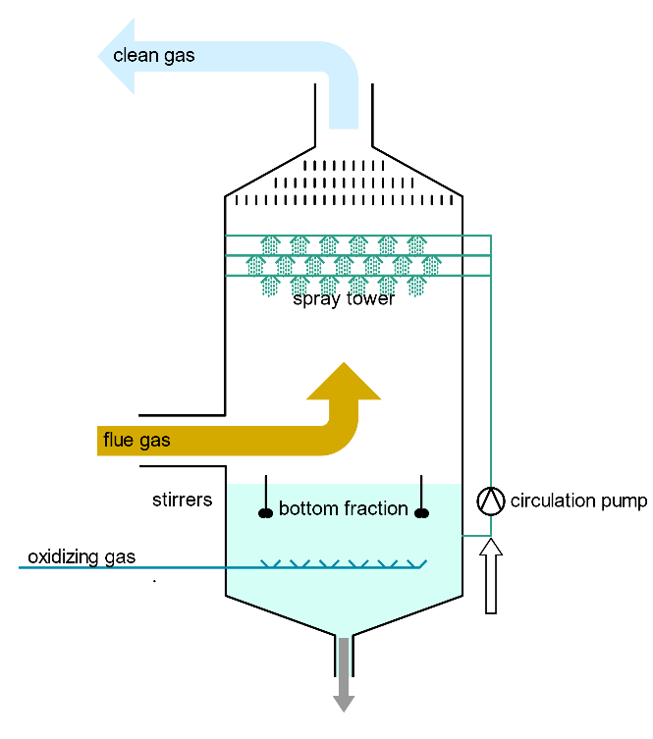
Innovative magnesium FGD vs standard calcium FGD
General concept and chemical mechanisms are similar for calcium and magnesium based wet FGD systems.
For both systems sorbent is mixed with water and sprayed in absorbtion tower to wash flue gas and absorb SO₂.
What is the difference?
Key difference is the product of chemical reaction.
sorbent
by-product
Source: Wikipedia

Slide 6
Magnesium based wet FGD concept
Crystallization unit
Adiabatic evaporation
unit
Filtration unit
Drying unit
Storage silo
Absorption unit

Slide 7
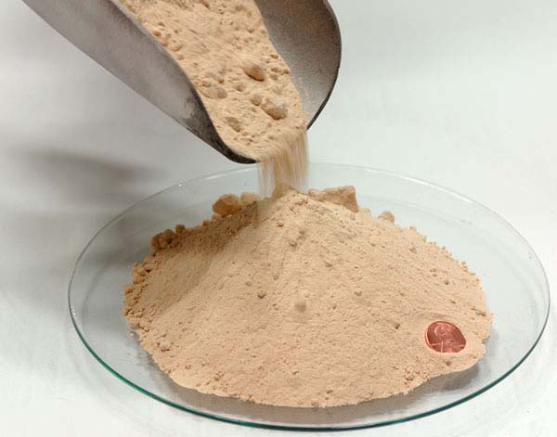
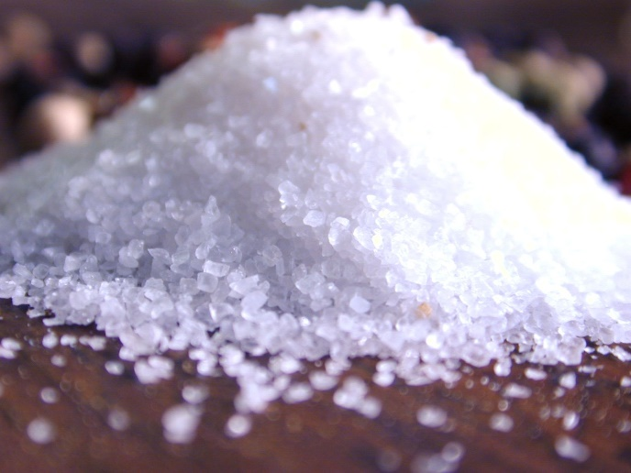
Innovative magnesium FGD vs standard calcium FGD
Source: https://www.alibaba.com/product-detail/synthetic-gypsum_50029556258.html
Source: http://www.matuta.de/chemicals-for-balling/Magnesium-sulfate-heptahydrate.html
 | Synthetic Gypsum | Magnesium Sulphate
Form | Non-soluble solid, white powder | Easily soluble white or colorless crystals
Usage in Turkey | Non | Agriculture, chemistry, cosmetics, pharmacy
Market price | $0/t | $150-210/t

Slide 8
Agenda
Introduction
Innovative magnesium FGD vs standard calcium FGD
Combustion byproduct - application as fertilizer
Kangal Tirmik - case study
Summary

Slide 9
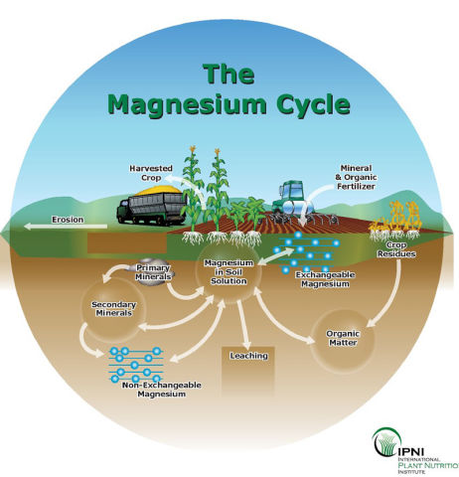
Magnesium in agriculture
Magnesium is a key element of chlorophyll molecule in plant tissue. Thus, if Mg is deficient, the shortage of chlorophyll results in poor and stunted plant growth.
In agriculture, magnesium sulfate is used to increase magnesium or sulfur content in soil. It is most commonly applied to potted plants, or to magnesium-hungry crops. The advantage of magnesium sulfate over other magnesium soil amendments is its high solubility, which also allows the option of foliar feeding. Solutions of magnesium sulfate are also nearly pH neutral therefore, the use of magnesium sulfate as a magnesium source for soil does not significantly change the soil pH.
Source: https://extension.umn.edu/micro-and-secondary-macronutrients/
magnesium-crop-production

Slide 10
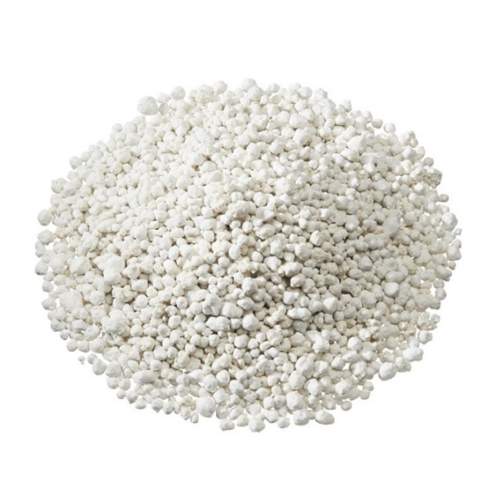
Magnesium fertilizer market
Global Magnesium Sulphate has very broad market in 21st century and it has been evaluated as $755.72 MM. Countries located in APAC region like India, China and Japan where healthcare and agriculture sector together contributes more than 40% of total GDP. The value of Magnesium Sulphate markets is expected to be $1071.42 MM by 2025.
In Magnesium Sulphate market, the Agricultural holds an important share in terms of applications and main recipients.
The global production of ready - made mineral fertilizers in 2018 amounted to almost 4.1 million Mg and was nearly 32.5% higher compared to 2014.
Nowadays, Asia-Pacific region is recognized as one of the major markets for Magnesium Sulphate Fertilizers, with India playing main role.
Source: Maia Research Analysis

Slide 11
Magnesium fertilizer market
CAGR (2019-2025) 7.70%
CAGR (2019-2025) 6.73%
CAGR (2019-2025) 8.24%
CAGR (2019-2025) 8.28%
CAGR (2019-2025) 7.34%
CAGR (2019-2025) 7.86%
Fig. Table Global Magnesium Sulphate Consumption Growth Rate by Application (2019- 2025) (K Tons)
(Source: Maia Research Analysis)

Slide 12
Magnesium fertilizer market
Asia-Pacific is one of the major markets, wherein India is expected to be the potential agricultural economy in the coming years.
Source: Global Magnesium Sulphate Market Insights, Forecast to 2025.

Slide 13
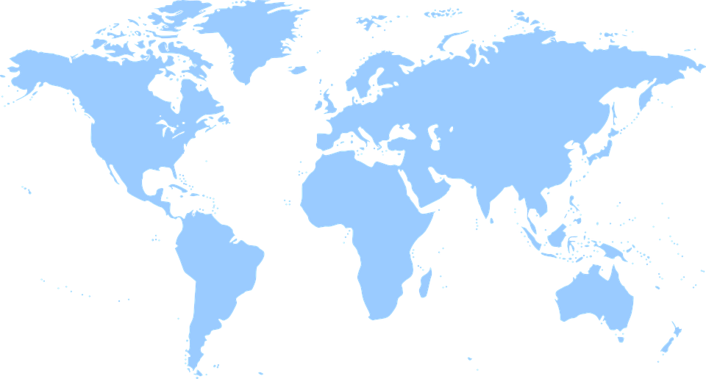
Magnesium fertilizer market
Since 2014, there has been an increase in the production of magnesium sulfate, which is a consequence of the rapidly growing demand for fertilizers in developing countries, in particular in China, India and Brazil.
North America 35,4 %
Europe 40,5 %
Middle East
and Africa 43,2 %
Asia Pacific 46,4 %
Central &
South America 50,2 %
consumption increase on the map in %
Based on Global Magnesium Sulphate Market Insights, Forecast to 2025.

Slide 14
Agenda
Introduction
Innovative magnesium FGD vs standard calcium FGD
Combustion Byproducts - application as fertilizer
Kangal Termik Santrali - case study
Summary

Slide 16
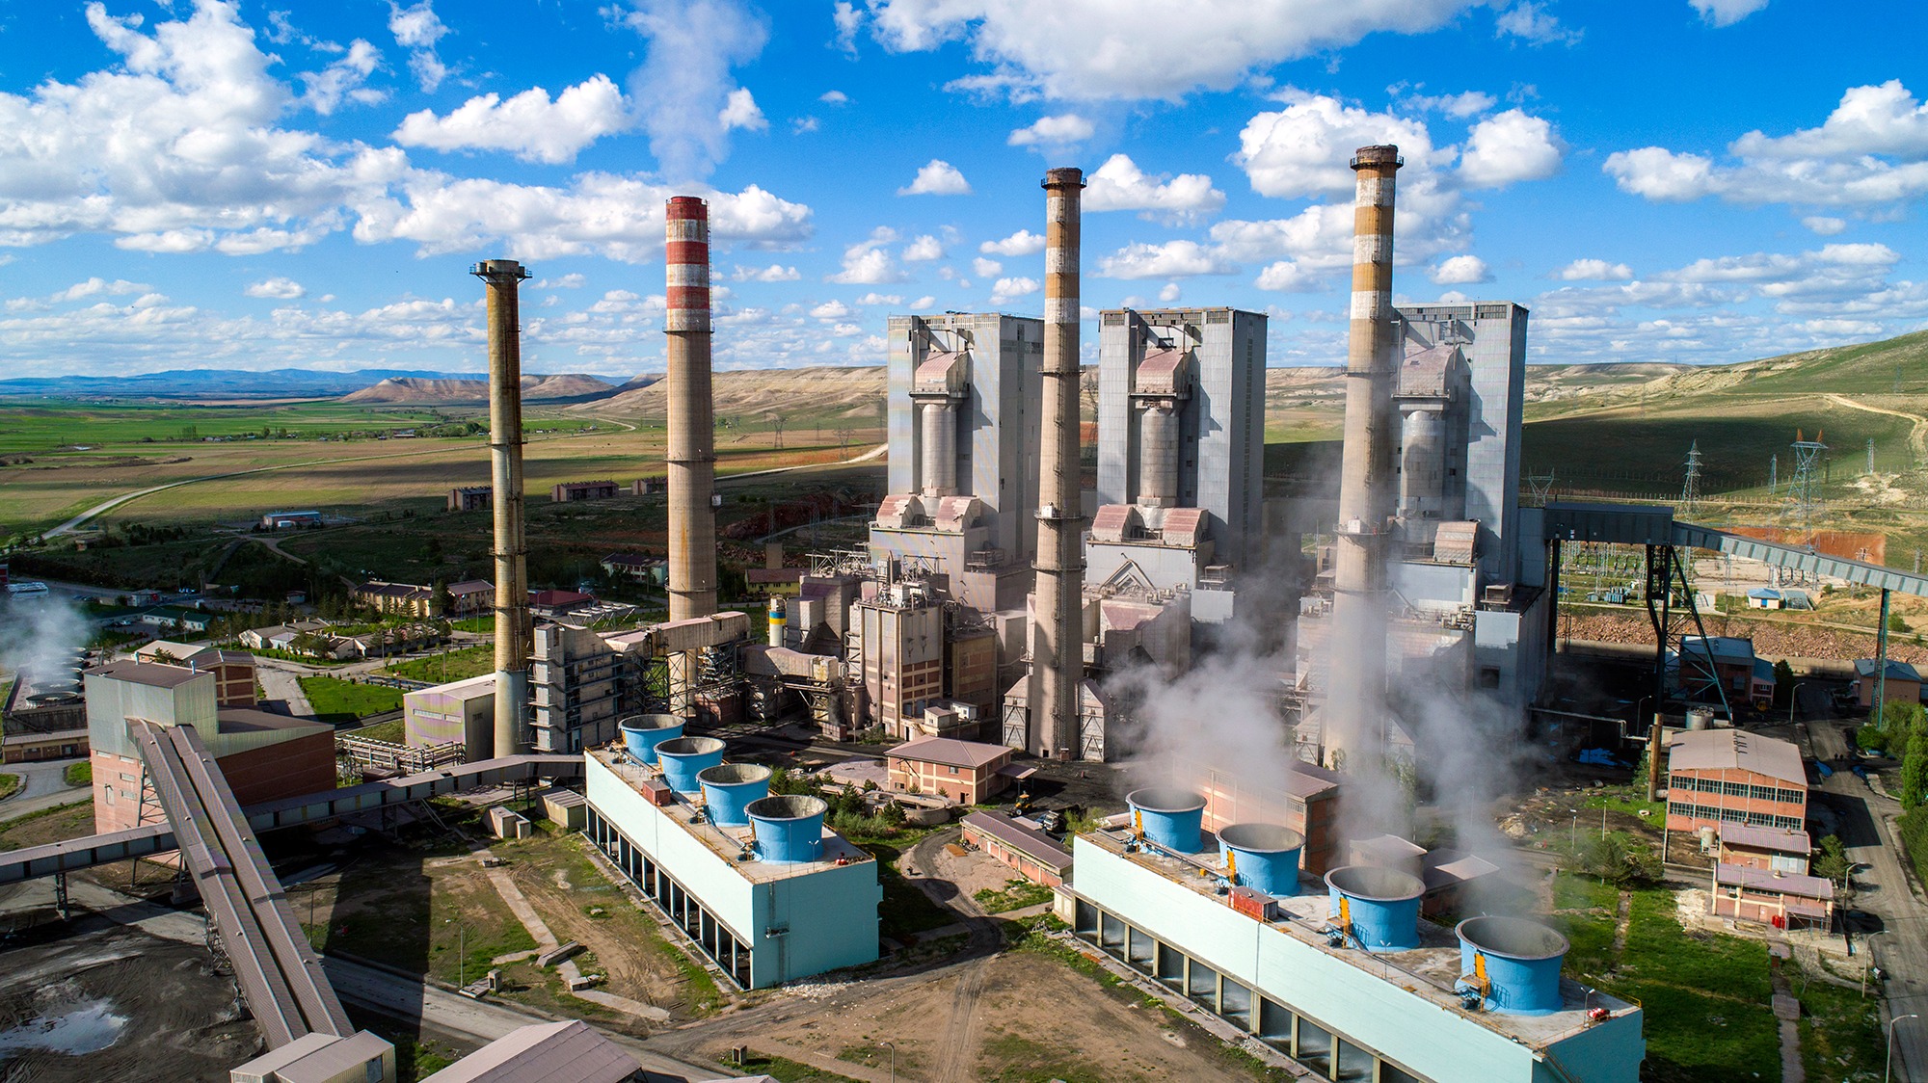
Kangal Termik Santrali

Slide 17
Kangal Power Plant general characteristics
 | UNIT 1 | UNIT 2 | UNIT 3
Commissioned | 1989 | 1990 | 2000
Power [MW] | 150 | 150 | 157
Flue gas flow (dry) [Nm³/h] | 860,000 | 860,000 | 860,000
SO₂ (dry, 6% O₂), max [mg/Nm³] | 12,500
Average annual operation time [h] | 7, 500 | 7,800 | 7,700

Slide 18
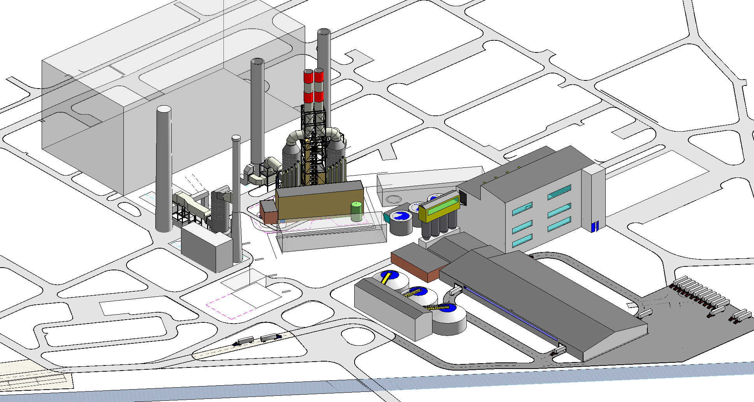
Kangal Power Plant general characteristics
Absorbtion unit 3
Absorbtion unit 1 & 2
Filtration, Crystalization, Drying
Packing warehouses
Mixture concentration

Slide 19
Emission reduction results
 | Current emission | Anticipated emission | Emission reduction | Emission reduction
Emission level [mg/Nm³] | 12 500 | 200 | 12 300 | 98.4%
SO₂ emission [kg/MWh] | 70.6 | 1.1 | 69.5

Slide 20
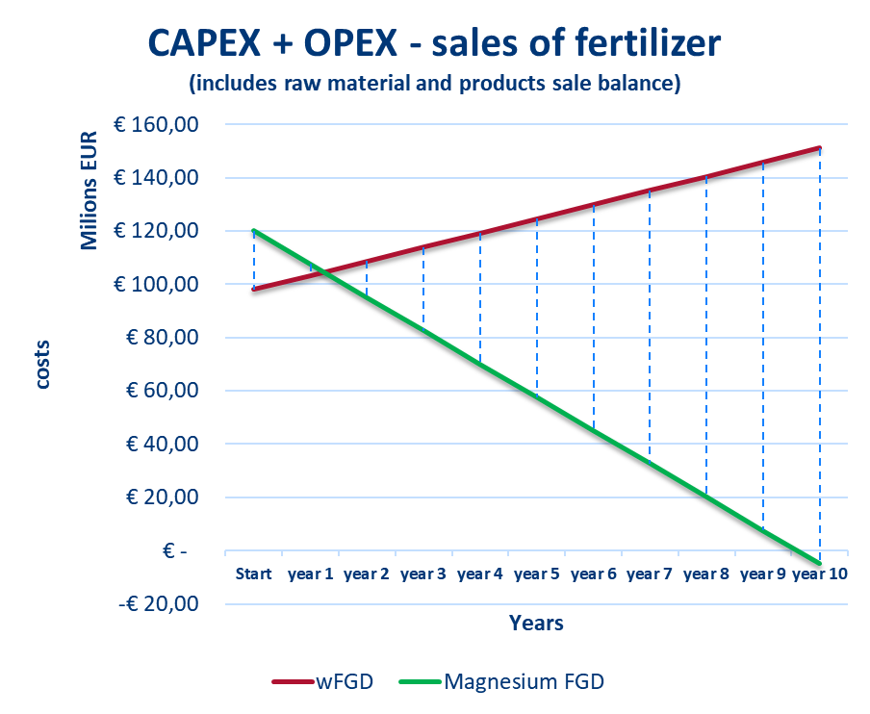
Kangal Power Plant general characteristics
Magnesium FGD
Higher CAPEX
OPEX costs of magnesium method are positively covered by fertilizer sale.
Calcium wet FGD
Lower CAPEX
Constant deliveries of limestone create high OPEX without possibility to sell byproducts.

Slide 21
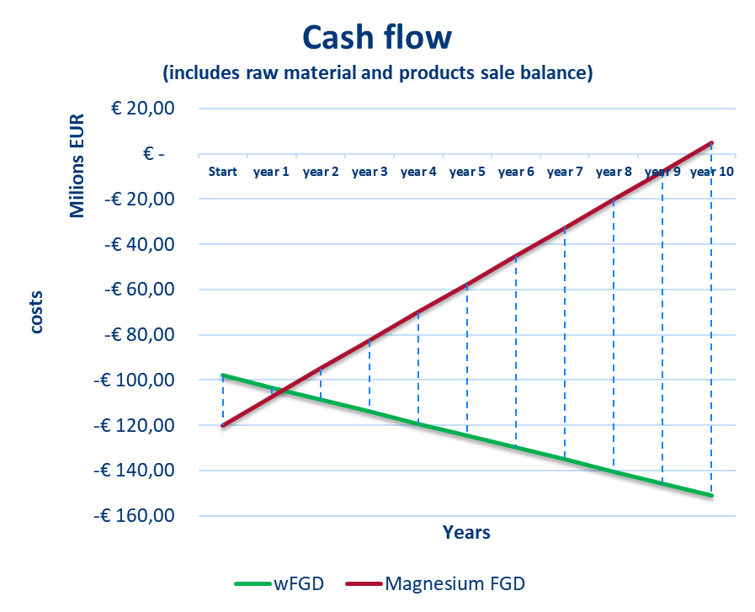
Kangal Power Plant general characteristics
Overall cashflow of the project is positive only in Magnesium method

Slide 22
Agenda
Introduction
Innovative magnesium FGD vs standard calcium FGD
Combustion Byproducts - application as fertilizer
Kangal Tirmik - case study
Summary

Slide 23
Summary
The largest of a kind
The first in Turkey
High efficiency of flue gas cleaning
Lower water consumption
Valuable byproduct
Great positive impact on environment

Slide 24
Thank you for your attention!

